Slide 1


Slide 2
Agenda
Time | Item | Speaker
12:30pm | Introduction to NHS Resolution and our service offer for the Independent Sector | Denise Chaffer Director of Safety and Learning Sally Pearson Responsible Officer and HPAN lead
12:40pm | IHPN and NHS Resolution working together to support improvement in safety and reduce harm | Dawn Hodgkins Director of Regulation at the Independent Healthcare Provider Network
13:00pm | Safety and Learning – Helping organisations to learn from harm | Denise Chaffer Director of Safety and Learning
13:20pm | Practitioner Performance Advice – supporting you to respond to concerns about performance | Sally Pearson Responsible Officer and HPAN lead
13:40pm | Q&A and discussion
13:55pm | Closing remarks

Slide 3



House keeping
Good afternoon and welcome
We will be recording this webinar (not the Q&A session at the end)
Please keep yourself on mute whilst our speakers are presenting
Time is designated for questions at the end of the session. Please add any questions into the Q&A tab throughout the talks
During the Q&A session feel free to raise your hand or continue to add any questions into the Q&A tab

Slide 4


Introduction to NHS Resolution and our service offer for the Independent Sector
Denise Chaffer
Director of Safety and Learning
Sally Pearson
Responsible Officer and HPAN lead

Slide 5
NHS Resolution purpose, functions and strategic focus:
Claims management
Practitioner Performance Advice
Our purpose is to provide expertise to the NHS to resolve concerns fairly, share learning for improvement and preserve resources for patient care.
Primary Care Appeals
Safety and Learning

Slide 6





Advise, resolve and learn: Our strategy to 2025
Priority 1.
Deliver fair resolution
Priority 2.
Share data and insights
as a catalyst for improvement
Priority 3.
Collaborate to improve maternity outcomes
Priority 4.
Invest in our people
and systems to transform our business
All of our services will focus on achieving fair and timely resolution, wherever possible keeping patients and healthcare staff out of formal processes to minimise distress and cost.
Bringing together key parties to determine what further improvements can be made within our areas of expertise to support the government’s maternity safety ambition.
Ensuring that our unique datasets help derive usable insights that benefit patients and the healthcare and justice systems.
Develop our people, systems and services so that we can continue to deliver best value for public funds.

Slide 7
IHPN and NHS Resolution working together to support improvement in safety and reduce harm
Dawn Hodgkins
Director of Regulation at the Independent Healthcare Provider Network
21 Aug 2023

Slide 8
Independent healthcare provision – overview
Scope:
IHPN members treat NHS patients and privately funded patients – around 2¼ million acute patient journeys across the sector in 2022, including over 1.4m NHS patient journeys
We have members across all four nations
Focusing on NHS patients treated in England by independent providers:
Acute:
  19% RTT admitted and 7% non-admitted pathways over past 12 months
  45% of ophthalmology and 31% of trauma & orthopaedic RTT NHS admissions by independent providers
Community & primary care
  IHPN members provide over 300 community services, predominantly commissioned by ICBs
Diagnostics
  Over 3.5m scans and tests were delivered by independent diagnostics providers in 2022

Slide 9
Medical Practitioners Assurance Framework (MPAF)
What shaped the MPAF
As the details that surrounded the criminal acts of Ian Paterson started to come to light, the Independent Sector recognised the need to improve its approach to clinical governance medical practitioner assurance.
The state of care in independent acute hospital – CQC 2018
The Paterson inquiry report – February 2020
Development of the MPAF
External chair – Sir Bruce Keogh
External Advisory Group – including NHS Resolution
Provider Reference Group – from across the IHPN secondary care membership
Final product
A document that links together key guidance and standards such as from GMC, NHS England, PHSO and NHS R.

Slide 10
NHS Resolution and IHPN
NHS Resolution
have acted as a key contributor, critical friend and helped to create a bridge across from NHSE focused guidance to the IS through the development of the MPAF, inputted into the Impact Review and helped in the development of the MPAF Refreshed document, launched in 2022.
Shared views on language and content, particularly around ‘just culture’ and openness.
Provided alignment with Maintaining High Professional Standards (MHPS) and other NHS focused documents.
Sough views from IHPN and members as they refresh their own documents and guidance to better reflect both NHS provided and IS provided NHS patients care.
Continue to support the sector through sessions such as today to improve safety and reduce harms.
Continued work
MPAF implementation
Updates on claims trends and themes
Continue to be a valued critical friend

Slide 11
Any questions?

Slide 12
Safety and Learning – Helping organisations to learn from harm
Denise Chaffer
Director of Safety and Learning

Slide 13
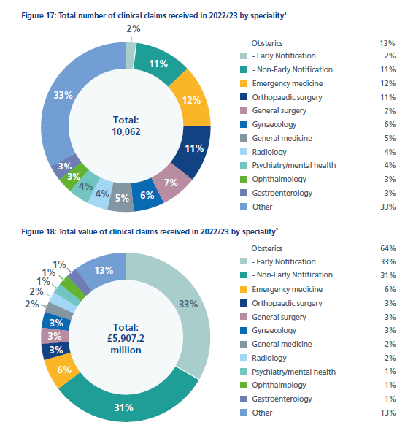
The percentage of clinical negligence claims reported in 2022/23 by specialty, with a breakdown by volume and by value
Total number of claim by number Total number of claims by value

Slide 14
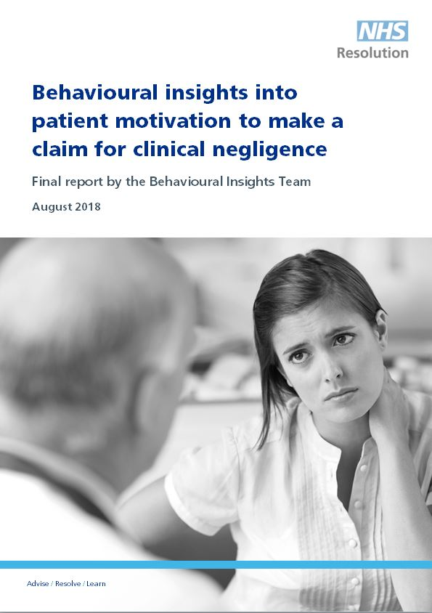
Why do people claim?
NHS Resolution’s research into behavioural insights August 2018
10,000 former claimants approached. 728 responded and in-depth interviews undertaken with a sample
Key conclusions:
NHS staff reactions generally considered inadequate
Majority not satisfied with the NHS complaints handling process
Suggestion from NHS staff major motivation to claim

Slide 15
What do people expect?
What do patients and families want?
  An apology
  To prevent it happening to someone else
  To understand what went wrong
  To have answers and be heard
  Compassion, understanding and support
  Signposting to support where appropriate
What do staff want?
  Help to say sorry
  To prevent it happening to someone else
  To understand what went wrong
  To have answers and be heard
  Compassion, understanding and support
  Signposting to support where appropriate

Slide 16

Saying sorry
Saying sorry meaningfully when things go wrong is vital for everyone involved in an incident, including the patient, their family, carers, and the staff that care for them.
Saying sorry is:
  always the right thing to do
  not an admission of liability
  an acknowledgement that something could have gone better
  the first step to learning from what happened and preventing it recurring

Slide 17
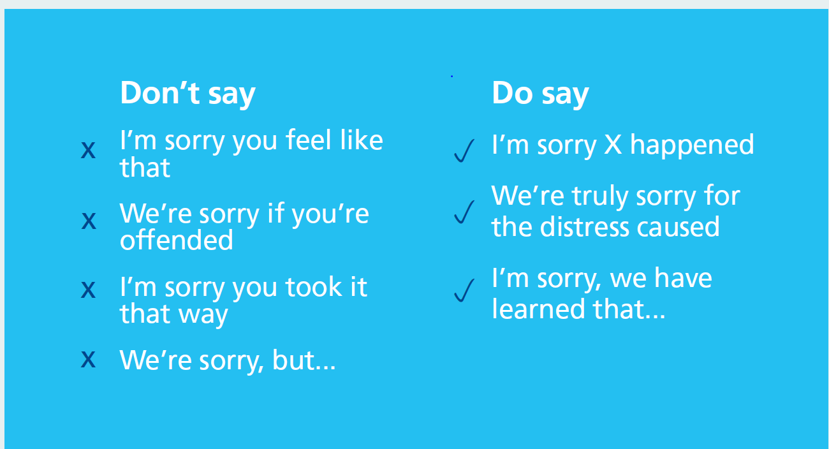
Saying Sorry

Slide 18
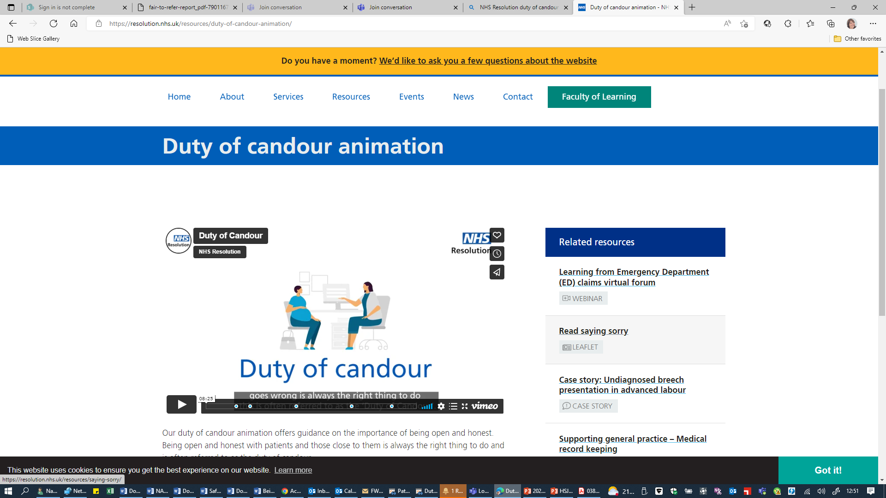
Duty of Candour
Duty of candour animation

Slide 19

Being fair: supporting a just and learning culture for staff and patients following incidents in the NHS
A just and learning culture is the balance of fairness, justice, learning – and taking responsibility for actions. It is not about seeking to blame the individuals involved when care in the NHS goes wrong. It is also not about an absence of responsibility and accountability.
All actions should be understood
Staff should be supported to learn from their actions
Chaffer, D., Kline, R. and Woodward, S.

Slide 20
Three aims of Being Fair
To help the NHS prioritise learning about how to minimise the conditions and behaviours that can underpin or lead to things not going as planned rather than apportion individual blame
Help the NHS build a consistent approach for all staff, no matter what profession or background
Help the NHS to avoid, wherever possible, suspension, exclusion and disciplinary action unless there is wilful intent

Slide 21
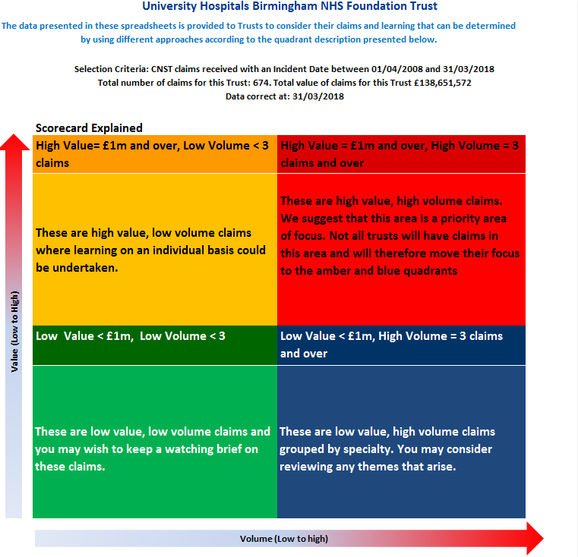
Scorecards
Quality improvement tool
Ten years of claims data
Open and closed claims
Updated annually
Supports thematic analysis
Scorecard guide https://tinyurl.com/ybz6s5jk

Slide 22
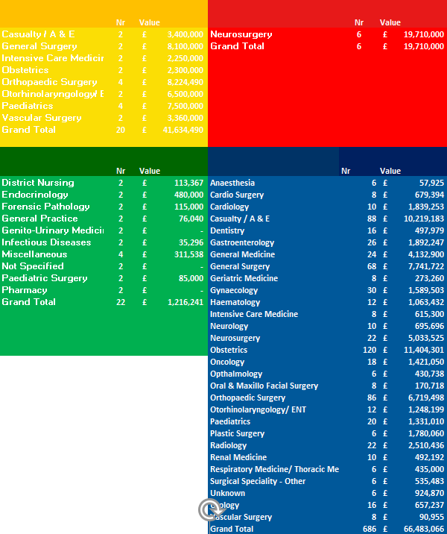
‘Wimbledon Common’ mock scorecard
Total number of claims: 734
Total value: £129,043,796

Slide 23
ISP clinical negligence claims reported between 2018/19 and 2022/23, with a breakdown by volume and by total claims cost

Slide 24
ISP clinical negligence claims reported between 2018/19 and 2022/23, by highest value injury and total claims cost

Slide 25
Example ISP claims
Orthopaedic
Incorrect size hip replacement used resulting in pain and revision surgery.
Settled circa £58k
Gynaecology
Alleged lack of fully informed consent prior to hysterectomy.
Settled circa £55k
General surgery
Bowel injury sustained and delayed recognition following laparoscopic cholecystectomy.
Settled circa £40k
Ophthalmology
Incorrect lens fitted resulting in poor vision and corrective surgery
Settled circa £5k
District nursing
Delayed recognition and treatment plan for sacral pressure ulcer leading to sepsis.
Settled circa £32k

Slide 26

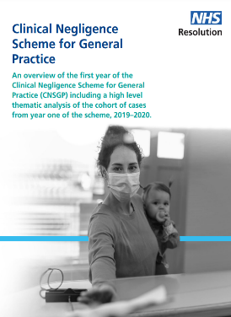

Thematic reports

Slide 27






Did you know? Medication errors
Click on any of the pictures to read the full leaflet.
You can find other some of our other products for learning via our website here.
Did you know? Insights into medication errors
Did you know? Anti-infective medication errors
Did you know? Heparin and anticoagulants
Did you know? General Practice Medication Errors
Did you know? Maternity Medication Errors
Did you know? Extravasation

Slide 28
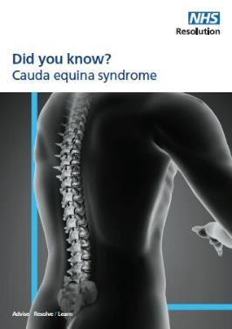






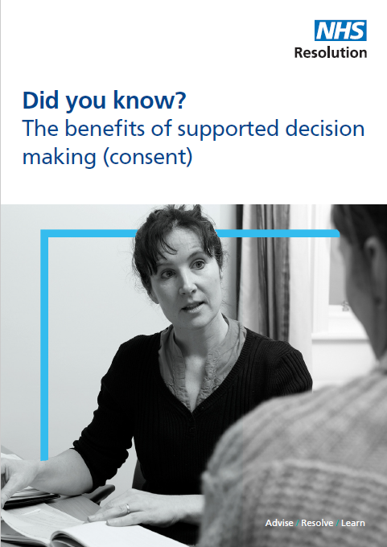




Resources
https://resolution.nhs.uk/resources/

Slide 29

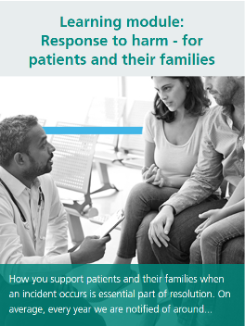
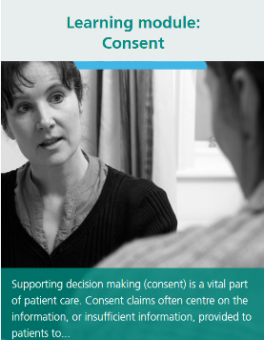
Faculty of Learning
https://resolution.nhs.uk/facultyoflearning/

Slide 30

Contact Safety and Learning
NHS Resolution
8th Floor,
10 South Colonnade, London,
E14 1SB
020 7811 2700
nhsr.safety@nhs.net
@NHSResolution
https://resolution.nhs.uk

Slide 31
Practitioner Performance Advice – supporting you to respond to concerns about performance
Sally Pearson
Responsible Officer and HPAN lead

Slide 32
How we support resolution of concerns
Practitioner Performance Advice Service
Advice
Education
Assessment and
Remediation
Healthcare Professional Alert Notices (HPANs)
Assisted mediation
Behavioural assessments
Clinical performance assessments
Professional support and remediation
Team reviews
https://resolution.nhs.uk/services/practitioner-performance-advice/

Slide 33
Practitioner Performance Advice
Who do we advise – NHS bodies/Individual practitioners plus non-NHS bodies
England, Northern Ireland, Wales, Isle of Man, Channel Islands
Free
No threshold for contacting us
Around 900 requests a year
Adviser team are senior staff with backgrounds in clinical, human resources and legal professions
Link Adviser
When to contact us
Source: https://resolution.nhs.uk/practitioner-performance-advisers/

Slide 34
What to expect
Expert and impartial advice to keep patients and doctors safe
Signposting to relevant regulation, policy, national frameworks and good practice guidance
Appropriate constructive challenge to thinking/proposed actions
Advice on developing an open and constructive dialogue between parties
The advice and rationale for it put in writing

Slide 35
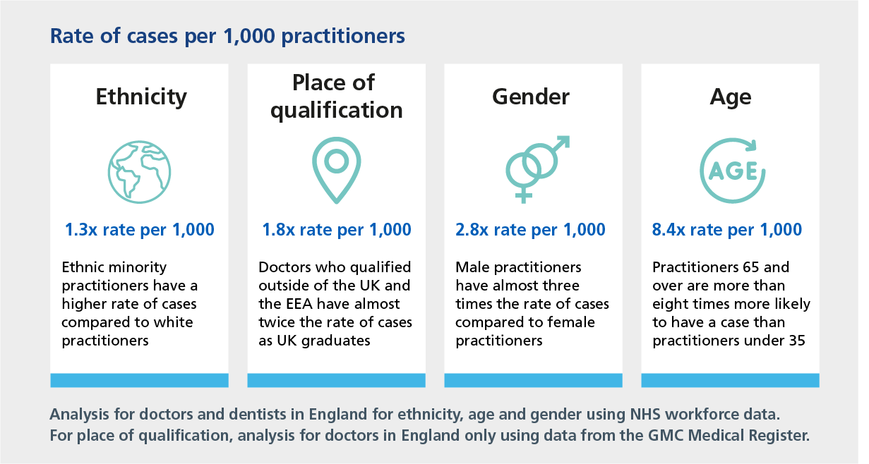
Rates of cases by personal characteristics

Slide 36
Reported concerns - overall
3,800
Cases
FY 2018/19 – 2022/23
Behaviour / misconduct concerns
70%
45%
17%
17%
Clinical concerns
40%
3%
5%
3%
Health concerns
18%
7%
Practitioner Performance Advice

Slide 37
How can we help you?
Managing concerns about connected doctors or employed practitioners
Determining a response to concerns identified elsewhere relating to a practitioner with practising privileges
Clarifying appropriate sharing of information relating to a practitioner who has clinical activity elsewhere
Access to our assessment and remediation interventions
Resources and support to help you build capacity and capability in managing performance concerns

Slide 38
Insights available
We have produced insights publications on a range of subjects including:
Research into concerns raised by healthcare organisations about practitioners
Practitioner Performance Advice Casework during the Covid-19 Pandemic
Bullying and harassment reported in our advice cases: an overview
Team reviews retrospective
Findings from clinical performance assessments – February 2022
Insights from 10 years of supporting the management of exclusions in England
Who are the practitioners we advise on and are there any patterns of concerns?
Behavioural Assessments: findings from an in-depth qualitative and quantitative analysis
Healthcare Professional Alert Notices (HPANs): insights from nine years of managing the scheme
Professional Support & Remediation (PSR): key features of recent action plans
Supporting the management of performance concerns within primary care - NHS Resolution
Notes:
FACILITATOR NOTE:
Point out this is an emerging body of knowledge.

Slide 39
Contact Practitioner Performance Advice
NHS Resolution,
8th Floor
10 South Colonnade
Canary Wharf London
E14 4PU
020 7811 2600
nhsr.advice@nhs.net
Events team:
@NHSResolution
Adviceducation@resolution.nhs.uk
https://resolution.nhs.uk

Slide 40
Question and answer

