Slide 1


Add
South Region Safety and Learning Networking Forum
11th December 2024
12.00 – 14:00
@NHSResolution

Slide 2

Housekeeping
This is event is being recorded.
Please use the chat box to submit any questions.
Feel free to share your innovations in the chat.
An online feedback link will be shared in the chat at the end and emailed after the webinar.

Slide 3
Agenda
Time | Item | Speaker
12:00 | Introduction to the forum | Chair, Ingrid Henderson, NHSR Associate Safety and Learning Lead – London and the South
12:05 | PSIRF update | Phil Meakin, Head of Clinical Quality and Improvement Hampshire, Isle of Wight and Thames Valley and Louise Jane, NHSE PSS for South East Region
12:30 | Violence in the workplace report | Naomi Assame, Deputy Director for Safety and Learning
12.50 | Workplace violence case story | Abigail Fogarty, NHSR Associate Safety and Learning Lead London
13.05 | Practitioner Performance Advice, update and maternity team reviews | Neil Armstrong
13:20 | Member led breakout groups facilitated by NHSR | Tim Shurlock - NHSR Safety & Learning Lead South Caroline Latham-Parker- NHSR Associate Safety & Learning Lead South Abigail Fogarty and Ingrid Henderson
13:50 | Summary and Close | Tim Shurlock

Slide 4
PSIRF update for NHS Resolutions
11 December 2024
Presented by:
Louise Jane Phil Meakin
Senior Clinical Quality Improvement Manager Head of Clinical Quality Improvement
Notes:
Standard title slide

Slide 5
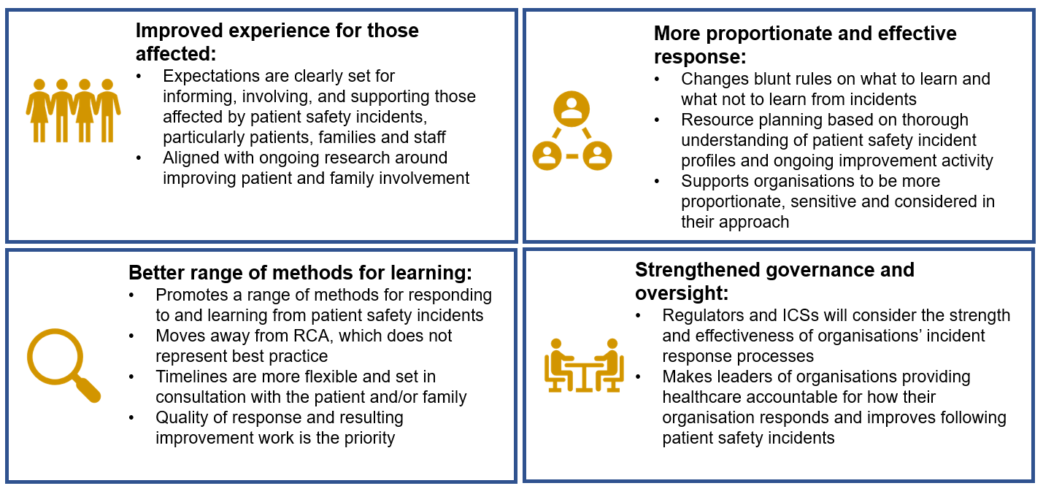
What does PSIRF aim to achieve?

Slide 6
What has changed?
Responses to incidents are no longer prompted by level of harm (although this is still recorded). The focus is on (new) learning opportunities to improve safety.
Focus on identified local safety priorities for detailed investigation (identified in a provider’s Patient Safety Incident Response Plan, PSIRP) and improvement using a system-based Patient Safety Incident Investigation (PSII) rather than a root cause analysis
Proportionate responses e.g., after action reviews, hot debriefs, thematic reviews used for incidents not identified for PSII
Traditional SI data replaced with safety measures that triangulate both qualitative and quantitative data
Governance of patient safety incidents is the responsibility of organisations via their governance processes and not an ICB process with formal closure panels
ICBs should review safety priorities across the system and coordinate improvement work
Regions have a role in the wider analysis of themes, supporting ICBs with improvement plans and sharing good practice across the region
PSIRF has not changed:
Duty of Candour requirement
Incidents that have established national reporting requirements – e.g., child deaths (CDOP), MH Homicide, screening programme incidents, incidents meeting HSIB criteria, safeguarding. These require a PSII/or equivalent.

Slide 7
Current position in the SE
All secondary care providers have transitioned to PSIRF
Independent sector organisations have made progress
Maternity engagement has been generally positive
Primary care (medical) national pilot – a small number of sites in the SE
Monthly steering group with ICBs, HINs, regional colleagues

Slide 8
Regional insight
Remain in the embedding phase, recognising this is a long-term cultural change programme that needs to follow QI methodology and sits within the wider patient safety strategy
Progressing towards a model of systems learning - peer review processes
A shift to learning for improvement is emerging to support proportionality of response - it can be ok to do nothing!
Anecdotal evidence of impact including staff feedback on empowerment and shift away from blame culture
Patient engagement through involvement of patient safety partners and family liaison officers
Positive celebration events, highlighting good examples and supporting QI.

Slide 9
Future consideration
The next 12 months…
Further embedding of PSIRF process and development of governance architecture for oversight of improvement
Priorities for support include executive/board engagement and PSIRF training
NE consultation
POD delegation
Development of safety management systems to include wider insight (ie. medical examiners) and support cross organisational learning
Triangulation of emerging patient safety priorities with NHS impact and operational planning to support sustained, targeted, improvement
How do we meaningfully share and spread the learning & improvement

Slide 10
End slide

Slide 11

Learning from workplace violence claims within the NHS- A thematic review
Naomi Assame
Deputy Director Safety and Learning
11th December 2024
Notes:
Good morning/afternoon. My name is….Title…bit about key foci of work.
Today, I am going to give you an overview of our recently released thematic review on learning from workplace violence claims within the NHS.

Slide 12
Overview of the session
About NHS Resolution
Background
Methodology
Results
Themes
Future areas of focus
Q&A
Notes:
To give you an overview of what I will be covering today…

Slide 13
Background

Slide 14
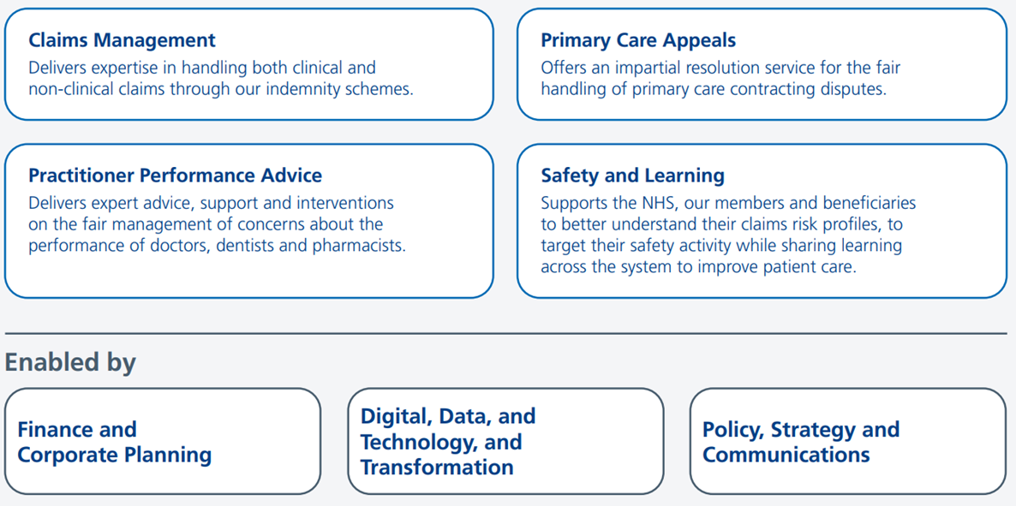
About NHS Resolution
Notes:
For those of you that are new to our work, and as a reminder for everyone else NHS Litigation Authority is a Special Health Authority and has been operating under the name of NHS Resolution (NHSR) since 2017, a name which better reflects our remit and purpose. The change was made to align with our corporate strategy launched in that year - a foundation which we continue to build upon.
We were established by Order of the Secretary of State for Health in 1995. Our original purpose was to establish and administer indemnity schemes for meeting the liabilities of national health service bodies. Our purpose now is a bit broader, with a focus on resolving concerns and disputes fairly, sharing learning for improvement and preserving resources for patient care.
On this slide you can see the different corporate services that make up our organisation:
Claims management
Safety and learning (That’s us!)
Practitioner performance advice
Primary care appeals
As a team in Safety and Learning we support our claims management service members to better understand their claims risk profiles in order to target their safety activity. Beyond engaging directly with our members, the Safety and learning team share their learning with the wider system- for example with the release of this thematic review, which I will now turn to.

Slide 15
Background
Why did we decide to investigate this issue?
How did we define workplace violence?
‘any incident in which a person is abused, threatened or assaulted in circumstances related to their work’ (Health and Safety Executive)
‘individuals who have experienced violence’ and ‘individuals who have exhibited violent behaviour’ (NHS England’s Violence Prevention Reduction Standard)
Notes:
It is important to understand how and why we decided to focus on workplace violence for one of our thematic review.
In 2020, the Health and Safety Executive published its Violence at Work Statistics report. It highlighted that healthcare professionals encounter a higher-than-average risk of workplace violence. Healthcare staff who have experienced workplace violence may choose to pursue a claim to compensate them for the personal and financial losses they have encountered during the course of their work. NHS Resolution’s Liabilities to Third Parties Scheme (LTPS) manages such claims.
Given our unique position and the lens of our claims data, this report specifically shares insights from claims that have been brought by NHS staff who have experienced workplace violence exhibited by patients in their care. Through this thematic review, an opportunity exists to consider the vital role leadership has in the prevention and reduction of workplace violence and the response of healthcare providers when workplace violence does occur within the NHS.
Another point that it is useful to get clear at the outset is what definition of workplace violence we have used. The Health and Safety Executive (HSE) defines work-related violence occurring within the healthcare setting as being any incident in which a person is abused, threatened or assaulted in circumstances related to their work. For the purposes of this thematic review and the context within which the issue of workplace violence is being considered, the HSE definition has been adopted.
NHS England’s Violence Prevention Reduction (VPR) Standard describes the impact language can have on those we engage with, especially those who have gone through trauma at some point in their lives. This thematic review aligns with the language used with the NHS England VPR standard and refers to ‘individuals who have experienced violence’ and ‘individuals who have exhibited violent behaviour’.

Slide 16

Methodology
Extraction of quantitative and qualitative data
Claims identified under our LTPS between the FYs 2010/11 and 2019/20
Data saturation
Limitations
Notes:
To undertake this review of workplace violence claims brought against the NHS in England, we extracted and analysed quantitative and qualitative data to identify themes emerging within claims and evaluate these to inform the areas of future focus emerging from this report.
We identified claims concerning workplace violence brought under the Liabilities to Third Parties Scheme between the financial years 2010/11 and 2019/20 from NHS Resolution’s Claims Management System. (S&L team member to use judgment in explaining why data is slightly dated)
We undertook a quantitative analysis of the included claims to identify the trends and themes.
To reach data saturation, we estimated that between 15 and 60 items (e.g. interviews, cases, etc.) will need to be analysed10. 40 claims selected at random for the qualitative analysis proved to be an adequate sample group as no new additional insights were being identified. The 40 claims analysed only included claims brought after 31 December 2015.
There are Let's limitations for this report that you should be aware of.
NHS Resolution covers trusts in England only and direct comparison with other devolved nations may not be helpful (although they are believed to have similar themes), particularly with different legal systems.
Our Claims Management System was primarily designed for managing claims, rather than for enabling the NHS to learn from compensation claims. Protected characteristic data are not coded for the purposes of management of the claim except sex and age. Claims are coded by claims managers, and many codes relate to legal process rather than individual outcome, which can restrict analysis.
Lastly it is important to remember that claims data is not representative of all incidents that occur within healthcare.
With all that being said, the analyse of claims is a really important lens for the identification of system learning.
Lets have a look at our findings now!

Slide 17
Results

Slide 18
Results – Financial analysis
5,287 claims included in quantitative analysis
4,674 claims were closed
Total costs of closed claims was £61.4m
63% of closed claims were unsuccessful
Total value of damages paid for the closed successful claims was £31.2m

Slide 19
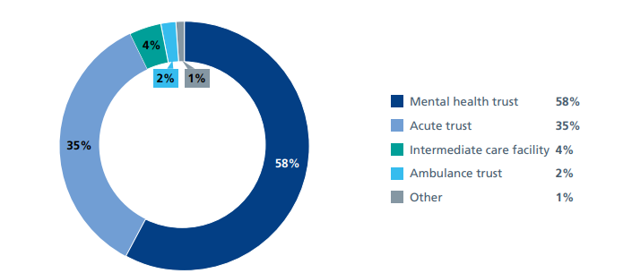
Results- organisational analysis
Notes:
We reviewed the successful claims and classified them into types of organisation where the incident occurred. As Figure 1 demonstrates, mental health settings accounted for the highest volume of workplace violence with 1,008 claims (58%).

Slide 20
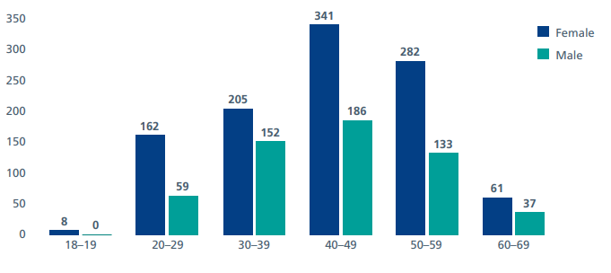
Results- workforce analysis
Notes:
Of the successful claims (65%) of those pursuing a claim for workplace violence were female and (35%) were male. As illustrated in the figure on this slide the greatest number of claims were made by individuals between the age range of 40 and 49; this was the same for both male and female staff members pursuing a claim for workplace violence.

Slide 21
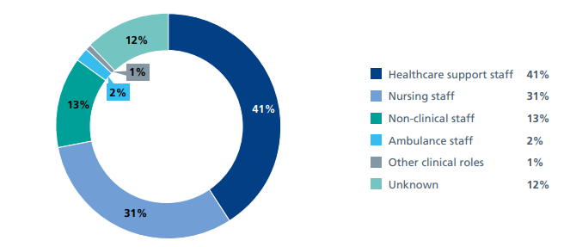
Results- workforce analysis
Notes:
We undertook further analysis of the successful claims to determine, where possible, the role of healthcare staff pursuing the claim. A key observation from this analysis is that healthcare support staff represented 41% of successful claims brought.

Slide 22
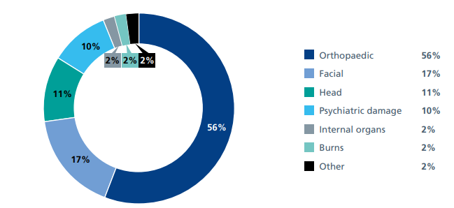
Results- injuries sustained
Notes:
We were also able to look into the type of injury sustained by healthcare staff who have experienced workplace violence and are pursuing a claim for compensation.
Orthopaedic injuries were most commonly reported and accounted for (58%) of claims. For an individual claimant, these could include multiple fractures including long-bone fractures. Facial injuries accounted for (17%) claims, head injuries accounted for (11%) claims and psychiatric damage accounted for (7%) claims.

Slide 23
Themes
Notes:
We analysed a sample of 40 successful closed claims, 20 from mental health trusts and the other 20 from acute trusts.
There are three key areas that came through our analysis
Regulatory breaches
Issues with workforce
Problems with care provision
I will take each in turn now…

Slide 24

Regulatory breach
Our findings aligned with HSE’s previous findings.
Management of Health and Safety at work Regulations (1999)
  Regulation 3
Notes:
A breach of the 1999 Management of Health and Safety at Work Regulations Act was cited in each of the 40 claims. The most frequently breached regulations were 3, 4, 5 and 13.
Regulation 3 requires employers to undertake suitable and sufficient risk assessments and was cited in 90% of the claims reviewed.
This finding aligns with those of the HSE which, between 2018 and 2022, carried out a series of inspections across 60 NHS trusts in Great Britain to assess the management and control of violence and aggression in the NHS13. In 60% of trusts inspected, the laws aimed at preventing and reducing workplace violence were contravened. A common feature where contraventions were seen included the failure of NHS employers to conduct suitable and sufficient risk assessments to control the risk to employees of experiencing workplace violence.
In the claims reviewed, some risk assessments were based on a singular rating of risk whereas others were based on a rating of risk involving multiple factors. Where risk assessments were reviewed frequently, the level of detail diminished with an increasing tendency to use the phrase ‘unknown’. Risks were described broadly, for example as ‘risk to service users or staff secondary to violence and aggression by service users’, without identifying the specific factors that were driving the existence of the risk, for example a previous history of exhibiting violent behaviours. It is possible that this resulted in the cumulating risk of violence not being recognised, communicated or mitigated against
Approaches to assessing and managing the risk of violence and aggression are outlined within the guidance, including standardised tools to support risk reduction and the requirement to frequently review risk assessments and risk management plans. Despite the existence of this guidance, of the claims reviewed, there was no standardised approach to assessing risk of workplace violence.

Slide 25
Regulatory breach
Management of Health and Safety at work Regulations (1999)
  Regulation 4
Notes:
Regulation 4 of the Management of Health and Safety at Work Regulations (1999) concerns the implementation of preventative and protective measures and was cited in 40% of the claims reviewed. In these claims we noted an absence of alarm systems to alert others, for example in reception areas. In some claims, staff had been issued with personal alarms, but these did not work when activated.

Slide 26
Regulatory breach
Management of Health and Safety at work Regulations (1999)
  Regulation 5
Workplace (Health Safety and Welfare) Regulation (1992)
Personal Protective Equipment at Work Regulations (1992)
Manual Handling Operations Regulations (1992)
Notes:
Regulation 5 requires employers to ensure the effective planning, organisation, control, monitoring and review of the preventative and protective measures required by Regulation 4. A breach of Regulation 5 was cited in 85% of the claims reviewed. This breach also relates to Regulation 5 of the Workplace (Health, Safety and Welfare) Regulations (1992), the Personal Protective Equipment at Work Regulations (1992) and the Provision and Use of Work Equipment Regulations (1998), which were all cited within the claims reviewed.
These regulations concern the maintenance of the workplace, and of equipment, devices and systems, ensuring the suitable provision of personal protective equipment and ensuring that equipment provided is suitable for the intended use.

Slide 27
Regulatory breach
Personal Protective Equipment at Work Regulations (1992)
  Regulation 13
Manual Handling Operations Regulations (1992)
Notes:
Regulation 13 requires every employer to ensure that employees are provided with adequate health and safety training. A breach of this regulation was cited in 60% of the 40 claims reviewed in depth and is linked to Regulation 4 of the Manual Handling Operation Regulations (1992). This regulation outlines the duty of employers to avoid the need for their employees to undertake manual handling activity and, where unavoidable, to undertake a suitable and sufficient assessment of all such manual handling operations and reduce the risk of injury

Slide 28

Workforce
Frontline care staff
Staffing skill mix was inadequate
Delay in response
Lack of staff support
Notes:
Of the 40 successful claims reviewed, 90% were brought by those involved in the delivery of frontline care, the highest proportion of whom were Healthcare Assistants (60%). Claims brought by agency staff accounted for 15% of the 40 successful claims reviewed.
Of the claims reviewed, 45% cited the staffing skill mix as being inadequate. For example, staff had not undergone an appropriate induction or undertaken training on the prevention and management of workplace violence.
A delay in response was reported in 20% of claims, from colleagues who may not have received the appropriate training so did not feel able to respond. A delay in response may also be attributable to the time of day the episode of workplace violence occurred; 43% took place during unsocial hours, i.e. at a weekend or between the hours of 8pm and 7am.
Of the claims reviewed, 13% cited an absence of support for those affected by workplace violence. We noted that documents included the impact and reaction of the individual who exhibited violent behaviour but not of the staff who were exposed to violence.

Slide 29

Care provision
Mental health settings
Inappropriate patient placement
Inadequate plans of care in place
Notes:
As a reminder mental health settings accounted for the highest volume of workplace violence with 58% of claims.
This finding aligns with the Royal College of Nursing’s 2021 Employment Survey20 which identified that respondents working in mental health settings were most likely to report having experienced both physical and verbal abuse.
In 18% of the claims reviewed, inappropriate patient placement was cited as a contributory factor, e.g. the service user met psychiatric intensive care unit criteria but was not transferred to that clinical service.
The absence of individual healthcare plans that met the needs of the patient and reduced the risk of violent behaviour were cited within 15% of the 40 claims.

Slide 30






Future areas of focus
Ensuring suitable and sufficient risk assessments
Training
Workforce
Staff support
Leadership
Development, implementation and evaluation of local policies
Notes:
The report identifies six areas of focus that NHS organisations should consider to reduce incidents of work related violence including:
Ensuring suitable and sufficient risk assessments.
Providing access to training on the prevention and reduction of workplace violence.
Ensuring sufficient staffing levels and that the skills mix is optimised and adequate.
If staff experience workplace violence, they should have access to a suitable package of support including immediate and long-term physical, emotional and financial support.
Developing, implementing and evaluating local policies in consultation with local trade unions and the wider healthcare system.
Ensuring that organisational violence prevention, reduction strategies and associated policies are endorsed by the Board or Senior Responsible Manager.
These areas of focus were co-designed with expertise of the project advisory group that included representatives from NHS England’s Violence Prevention and Reduction team, The Social Partnership Forum and the Health and Safety Executive.
The NHS continues to identify ways to tackle and reduce violence against staff. We believe this could be developed further through an NHS National Violence Reduction Strategy, a key element of which should include the collation of data concerning workplace violence locally, regionally and nationally.
The development of such databases will permit detailed analysis and rigorous evaluation of improvement measures implemented. The Social Partnership Forum is ideally placed to be involved in the development and implementation of such a strategy.

Slide 31


Introduction
This is an illustrative case story based off themes found within workplace violence claims. The aim is to share the learning from these. We encourage clinicians and organisations to reflect on how to prevent similar incidents, enhance patient safety and better protect staff.
As you read through this illustrative case story, please ask yourself:
  Could this happen in my organisation?
  How are workplace violence risks managed, and are staff adequately supported in high-risk situations?
  Do I feel safe to escalate concerns?
  How effective is communication within my organisation?
  Who could I share this with?
  What can we learn from this?
Advise / Resolve / Learn
Notes:
Good afternoon, everyone. My name is Abigail, I am an associative safety and learning lead for NHSR - and I am a mental health nurse by background. Today, I will be presenting a case story that is illustrative in nature, built around themes we often see in workplace violence claims and themes that you have seen within Naomi's presentation.
The case story also reflects pieces of work we have been doing within NHSR to really bring claim learning to life; to share learning as a catalyst for improvement through a different lens.
Making improvements in the workplace
And as we go through the details, I encourage you to ask your self –
So really reflecting on how similar incidents could potentially be prevented, how we can enhance patient safety, and how we can better protect staff in the workplace.

Slide 32
Learning from Workplace Violence: Case story
* Illustrative Case Story to outline themes found within LTPS WPV Claims: with review of WPV Report themes found in National LTPS Data Set.
Situation:
Handover was completed at the commencement of night duty. Due to the acuity and staff completing final tasks handover started late. The day shift had also been short staffed.
The ward had adequate staffing levels as per ward policy for night duty. Sarah a HCA working on the ward had x2 days of absence.
She was allocated the ward general/intermittent observations at the start of the shift. During that time x2 RMNS were administering a depot which had not been given on the day shift.
While completing observations the patient exhibited violence toward Sarah. Sarah suffered facial injury and psychological damage.
There was a delayed response once the duress was activated due to staff shortages and staff who did not feel they had appropriate training to respond.
Background:
A patient was admitted on a S2 to an Acute Mental Health unit. The patient had a diagnosis of paranoid schizophrenia experiencing auditory hallucinations of a derogatory nature.
They had a period of non-compliance with medication in the community.
The patient was assessed on admission by the treating team. They partially engaged with the assessment, as they presented as guarded and appeared to be responding to internal stimuli.
The patient was commenced on 15- minute intermittent observations.
Communication about the patient’s unpredictability and history of violence was not clearly passed between shifts.
Assessment:
Breach of Duty:
Inappropriate Placement.
Did not complete an adequate risk assessment for this patient and/or ensure adequate safeguards were put in place e.g., handover.
Did not to provide an appropriate number of staff on the ward at the time of the incident nor suitable numbers of PMVA trained staff.
Failed to provide an adequate number of staff on the ward at the time of the incident to assist the Claimant.
Recommendations:
To ensure adequate risk assessments are undertaken and effective training is delivered.
Ensure clear communication about patients presenting and historical risk. Implement a structured handover process.
Ensure adequate staffing, conduct staffing reviews to ensure there are enough trained professionals to provide safe care.
When staff experience workplace violence, a suitable package of support should be available.
Notes:
The case illustrates the importance of appropriate observation, clear communication, and adequate staffing in managing potentially high-risk patients in acute settings. By learning from these gaps, we can prevent similar incidents in the future and ensure both patient and staff safety.
In 18% of the claims reviewed, inappropriate patient placement was cited as a contributory factor, e.g. the service user met psychiatric intensive care unit criteria but was not transferred to that clinical service
Situation:
Due to the acuity and staff completing final tasks handover started late.
Background: Adx to Unit following noncompliance with medication resulting in a deteriorating patient state and increased risk.
There was adequate staffing levels according to unit policy. However, ward was acute, and 2 nurses were administering a depot as this had not been completed on the day shift due to acuity. ??Handover started late – rushed. A lot of staff were on 12 hour days; wanted to get out.
Night shift so already working on fewer staff members. Assaulted a HCA, felt targeted from the commencement of shift. Observations
Handover was poor – didn’t feel as though an adequate handover of historical risk was provided.
Has alarms been reset – does yours work?
Ciara: Historic risk is STATIC risk; understanding about that.

Slide 33
System/organisational concerns
Think about Being Fair/Just and Learning Culture:
Some of these are system/organisational issues that staff are working within.
Do staff feel able to escalate concerns within teams i.e., did the healthcare assistant feel safe to challenge the decision to go on observations when sufficient handover was not provided.
Have staff raised issues to senior team re. increased acuity and staffing issues.
Capacity issues
Night shift – reduced staffing.
Resource availability to respond on night shifts.
Staff training/skill mix.
Process issues
Environmental risks; are patients nursed in the appropriate environment.
Comprehensive communication during handovers.
Decision issues
Two staff doing medication whilst a healthcare assistant was conducting observations.
Delays in responding to escalating behaviour (escalation during day shift; was PRN provided).
Possible inadequate risk assessment.
Advise / Resolve / Learn
Notes:
This case story is really a skeleton of a clinical scenario, and as clinicians it may leave you wanting to know more about the situation
For the purpose of this activity, we ask you to think with a SEIPS hat on, considering how different areas of the system could influence the scenario….

Slide 34
Considerations: NHSR Workplace Violence Report
Have staff undergone an appropriate induction or undertaken training on the prevention and management of workplace violence
1
43% of WPV incidents took place during unsocial hours, i.e. at a weekend or between the hours of 8pm and 7am.
2
In 2020, the HSE published its Violence at Work Statistics report, which reported that healthcare professionals encounter a higher than-average risk of workplace violence, at 3.9%.
3
1,127 (65%) of those pursuing a claim for workplace violence were female and 606 (35%) were male.
4
No record of a breastfeeding assessment.
A common feature where contraventions were seen included the failure of NHS employers to conduct suitable and sufficient risk assessments to control the risk to employees of experiencing workplace violence.
5
6
Where risk assessments were reviewed frequently, the level of detail diminished with an increasing tendency to use the phrase ‘unknown’.
Advise / Resolve / Learn
NHS Resolution – Workplace violence claims – A thematic review

Slide 35

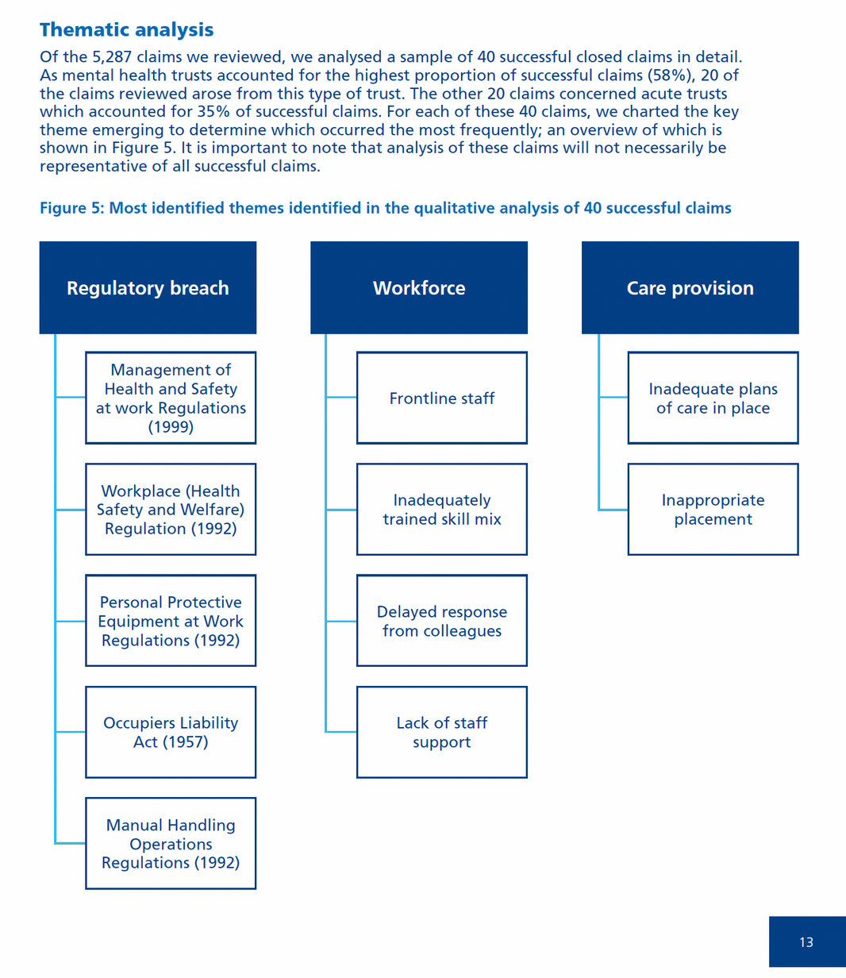
Most identified themes in the analysis
  Ensure suitable and sufficient risk assessments
  Training
  Workforce
  Staff support
  Leadership
  Development, implementation and evaluation of local policies
Advise / Resolve / Learn
Notes:
Key take aways
Suitable and sufficient risk assessments
Training –
Leadership
Staff support

Slide 36
Practitioner Performance Advice
Maternity Team Reviews
Neil Armstrong
Casework Systems and Guidance Manager

Slide 37
Our organisation
Enabled by:
Claims Management
Delivers expertise in handling both clinical and non-clinical claims through our indemnity schemes
Primary Care Appeals
Offers an impartial resolution service for the fair handling of primary care contracting disputes
Finance and Corporate Planning
Digital, Data and Technology, and Transformation
Practitioner Performance Advice
Delivers expert advice, support and interventions on the fair management of concerns about the performance of doctors, dentists and pharmacists
Safety and Learning
Supports the NHS, our members and beneficiaries to better understand their claims risk profiles, to target their safety activity while sharing learning across the system to improve patient care
Policy,
Strategy and Communications

Slide 38
What we do
Practitioner Performance Advice
Delivers expert advice, support and interventions on the fair management of concerns about the performance of doctors, dentists and pharmacists
Provide a range of core services to NHS organisations and other bodies in England, Wales and Northern Ireland such as advice, assessment and intervention, training courses and other expert services

Slide 39
How we support resolution of concerns
Practitioner Performance Advice Service
Advice
Education
Evaluation, Research and Insights
Assessment and
Remediation
Healthcare Professional Alert Notices (HPANs)
Assisted mediation
Behavioural assessments
Clinical performance assessments
Professional support and remediation
Team reviews
https://resolution.nhs.uk/services/practitioner-performance-advice/

Slide 40
Assessment and remediation
Our assessments help to clarify and understand the performance of individual practitioners (doctors, dentists and pharmacists), and provide the healthcare organisation and practitioner with a sound basis upon which to bring the case towards a resolution.
Behavioural assessment
Clinical performance assessment
Professional support and remediation
Assisted mediation
Team reviews/maternity team reviews
*there are charges applicable to some assessment and remediation services

Slide 41
Maternity team reviews – why?
The culture in a maternity service is directly related to the quality and outcomes of the service. Maternity service reviews have found evidence of team dysfunction, across different professional groups.
Importance of the role of the multidisciplinary team and working relationships between team members
To help provide a better understanding of the barriers to resolving behavioural issues within a maternity team and to suggest options for improving professional relationships.
The maternity team review is designed to play a valuable role in helping to address some of the factors that impact maternity performance in England.

Slide 42
Maternity team reviews – how?
Can cover a multidisciplinary team, including obstetricians and midwives, but also, and not exclusively, obstetric anaesthetists, neonatologists and maternity support workers.
It is not a service review nor an investigation but seeks through questionnaires and semi structured interviews with team members to understand their views on how the team functions and what the issues in the team may be
An outcome report which sets out diagnosis as well as recommendations to support a robust management plan and ongoing follow up support and monitoring to help facilitate sustained change.

Slide 43

Further information
Maternity team review – webpage
Maternity team review – case study
To discuss further, please contact:
Rineke Schram, FRCOG, Lead Assessment and Remediation Adviser rineke.schram@nhs.net
Advice team
nhsr.Advice@nhs.net

Slide 44




Thank you!
We hope you have found this event useful, please remember complete this short survey here to help us with future events
FOLLOW US
GET IN TOUCH
SCAN ME
@NHSResolution
nhsr.safety@nhs.net
NHS Resolution
Notes:
QR code above. https://www.smartsurvey.co.uk/s/QDXXA8/

