Slide 1

Add
South Regional Safety and Learning Networking Forum
25th March 2025
12:00 – 13:30

Slide 2

Housekeeping
This is event is being recorded.
Please use the chat box to submit any questions.
Feel free to share your innovations in the chat.
An online feedback link will be shared towards the end of the meeting and emailed after the webinar.

Slide 3
Agenda
Time | Item | Speaker
12:00 | Introduction to the forum | Chair, Caroline Latham-Parker, NHSR, Safety and Learning Lead – South
12:05 | Learning from staff claims relating to exposure of substances hazardous to health (20 mins) | Abigail Fogarty, NHSR, Associate Safety and Learning Lead, London Justine Sharpe, NHSR, Safety & Learning Lead, London
12:25 | Duty of Candour & PSRIF (20 mins) | Trudy Sexton , Devon Partnership NHS Trust, Patient Safety Manager
12.45 | Q&A (10 mins) | To be led by Ingrid Henderson - NHSR, Associate Safety & Learning Lead – London & South
12.55 | Member led breakout groups facilitated by NHSR (30 mins) | Caroline Latham-Parker Ingrid Henderson
13:25 | Summary and Close (5 mins) | Caroline Latham-Parker

Slide 4

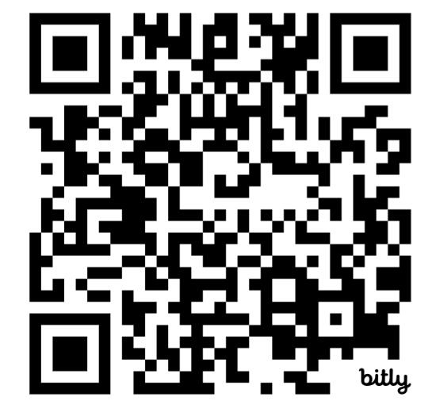
Learning from staff claims relating to exposure of substances hazardous to health Available to read on our website.
Justine Sharpe, Safety and Learning Lead
Abigal Fogarty, Associate Safety and Learning Lead
Notes:
The why?

Slide 5
Who are Safety and Learning team?
Commissioned and funded SoS to extract and support claims data for safety learning
Foster collaborative working and relationship building across the system to understand the issues and create materials to accelerate safety learning
MDT of clinicians with expertise as e.g. safety specialist/ QI /governance and so can support the uptake and spread of innovations
Summary of tools and our outputs:
Provide unique data as a catalyst for learning (claims scorecard)
System convener for earlier resolution
Influence policy change and improvements (see thematic reports)
Create material to support staff safety
Shared learning and showcasing impact

Slide 6
Background to the Chemical Hazards Resource
NHS Resolution has been a member of HSWG sponsored by NHS Employers and regularly shares claims learning to their workstreams. We were asked to explore whether there was an untold staff story/insight in data? Commissioned and shared data set. Identified some interesting insights that may help improve processes and learning.
Invited subject matter experts from HSWG to contribute to task and finish workstream to create a national digital resource that could be used by health organisations to improve safety training and local processes.
Now sharing this resource with trusts and organisations to adopt, use, and potentially identify any additional themes for learning to add to existing guidelines and practice.
  What do you feel is estimated cost and volume of claims in this area is?
What do you think the most common breach is?
Notes:
Ask the audience what do they think the vol and cost of claims in the area is?
This resource outlines risks associated with these exposures and illustrates learning from claims through illustrative case stories and an analysis of recurring themes in settled claims.

Slide 7


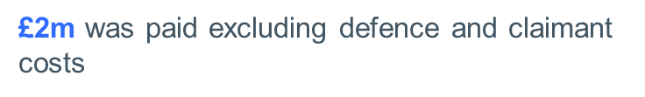
Did you know? Findings
Analysed LTPS scheme.
Alleged incidents occurring
between financial years 2013 and 2023.
Alleged regulatory breaches:
COSHH
Infect/Inhale/Irritation
Occup Illness/Disease
Accidental
Chemical Exposure
Illness disease
Exposure to Gluteraldehyde
Notes:
The Control of Substances Hazardous to Health Regulations (COSHH) Regulations 2002 (as amended) requires employers to:
Assess the risks that arise from the use of hazardous substances. This includes arrangements to deal with accidents, incidents or emergencies, such as those resulting from serious spillages. The assessment must also include health and safety risks arising from storage, handling or disposal of any of the substances.
Prevent or, if this is not reasonably practicable, control exposure to such substances.
Provide staff with information, instruction and training about the risks, steps and precautions the employer has taken to control these risks, e.g. provision of appropriate personal protective equipment (PPE). See the hierarchy of hazard control.

Slide 8
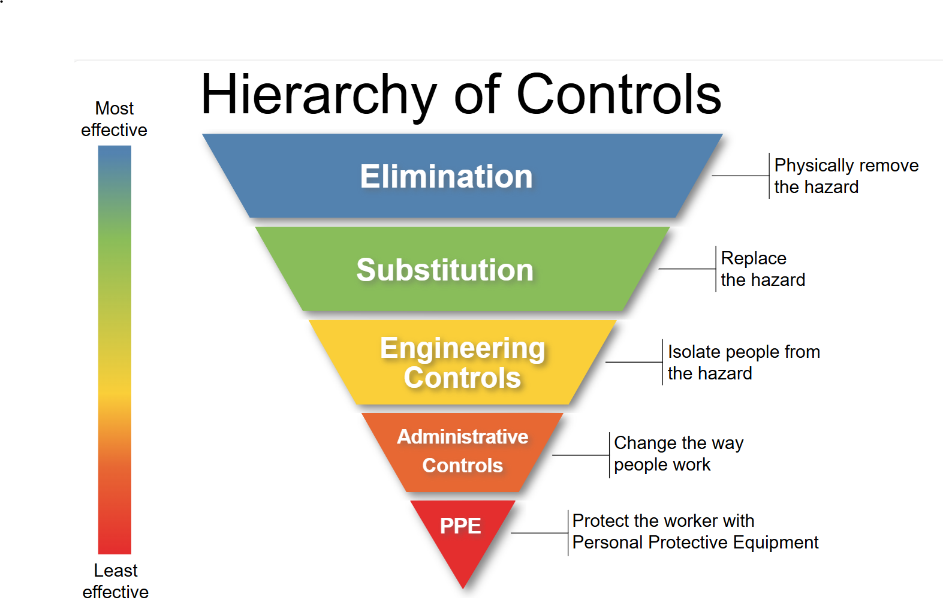
COSHH and hierarchy of controls
The Control of Substances Hazardous to Health Regulations (COSHH) Regulations 2002 requires employers to:
Assess the risks
Prevent (or, if this is not reasonably practicable);
Control exposure to such substances.
Provide staff with information, instruction and training about the risks, steps and precautions the employer
control these risks, e.g. provision of appropriate personal protective equipment (PPE).
Notes:
1. that arise from the use of hazardous substances. This includes arrangements to deal with accidents, incidents or emergencies, such as those resulting from serious spillages. The assessment must also include health and safety risks arising from storage, handling or disposal of any of the substances.

Slide 9
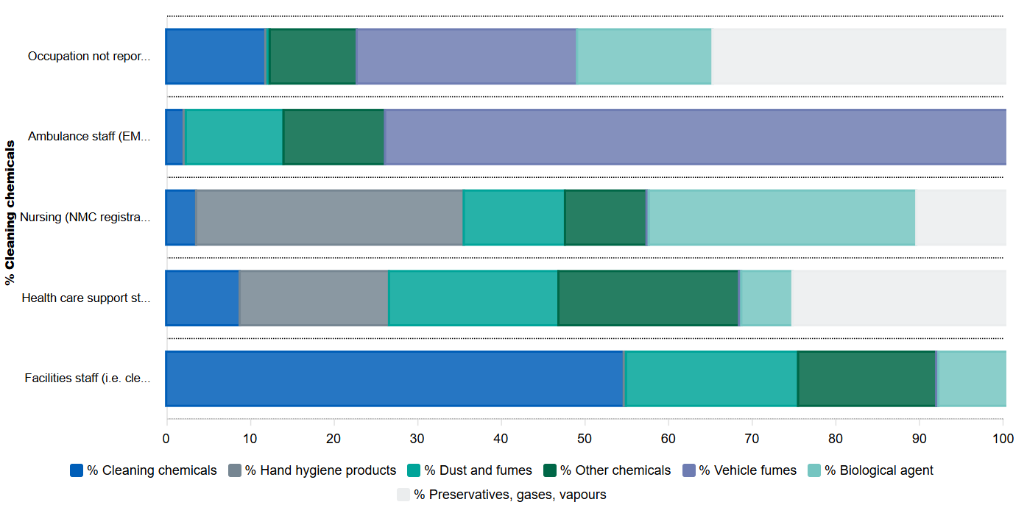
Figure 1: Chemical breakdown of substances hazardous to health by job role
Notes:
Where did we see the most staff impacted? Facilitates staff most

Slide 10
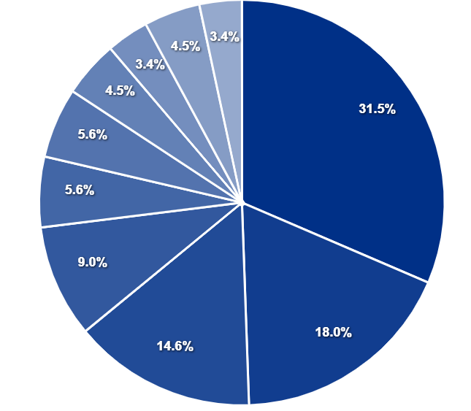
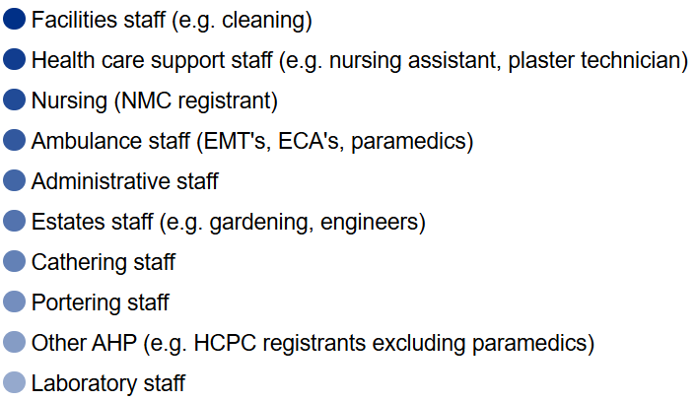
Figure 3: Total number of successful claims by occupation
Notes:
Facilities staff

Slide 11
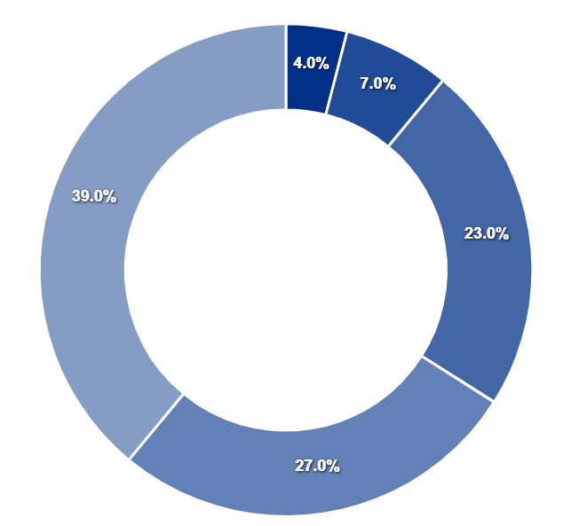
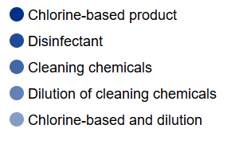
Figure 2: Breakdown of all chemicals

Slide 12
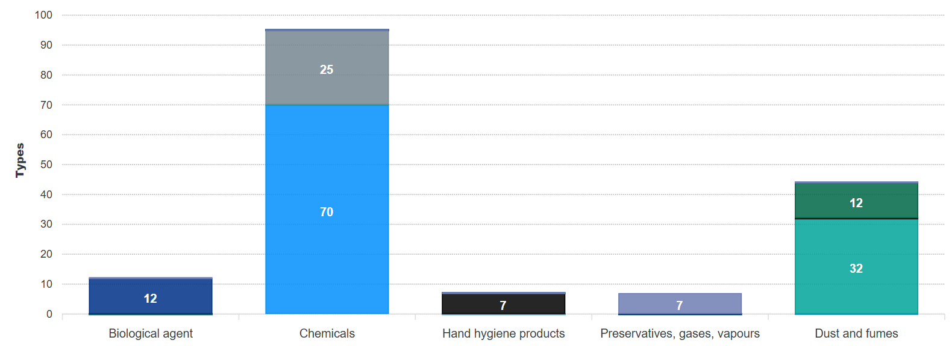
Figure 4: Claims related to substances hazardous to health

Slide 13
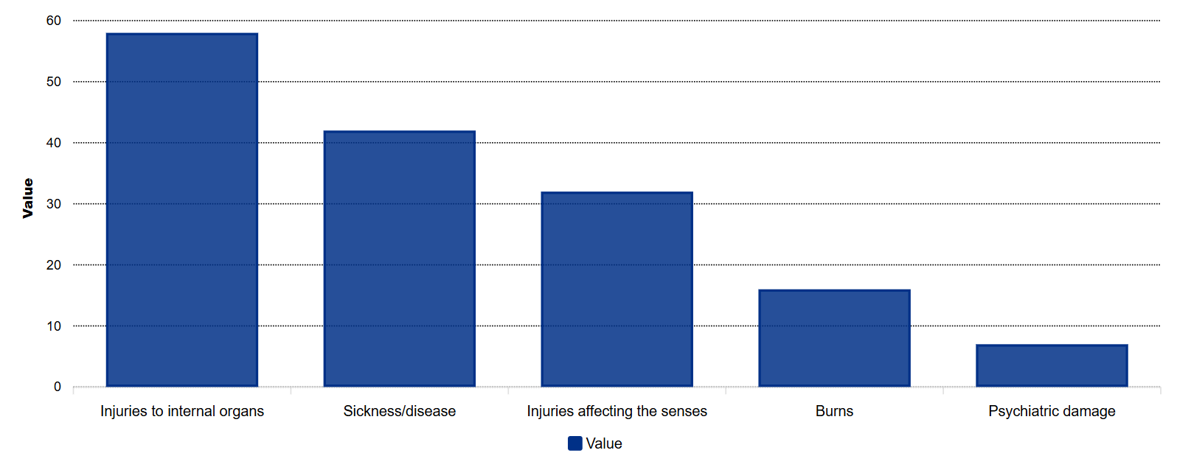
Figure 5: Injuries for claims settled with damages
58
42
32
16
7

Slide 14
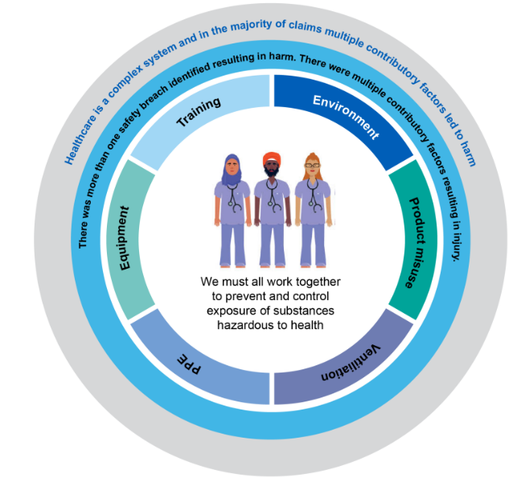
Did you know? Themes
In the majority of claims multiple contributory factors led to harm.
Often there was more than one safety breach which resulted in harm.
These include organisational failure to prevent exposure, failure to risk assess, failure to monitor exposure, and failure to provide adequate PPE and training.
Notes:
Abi

Slide 15
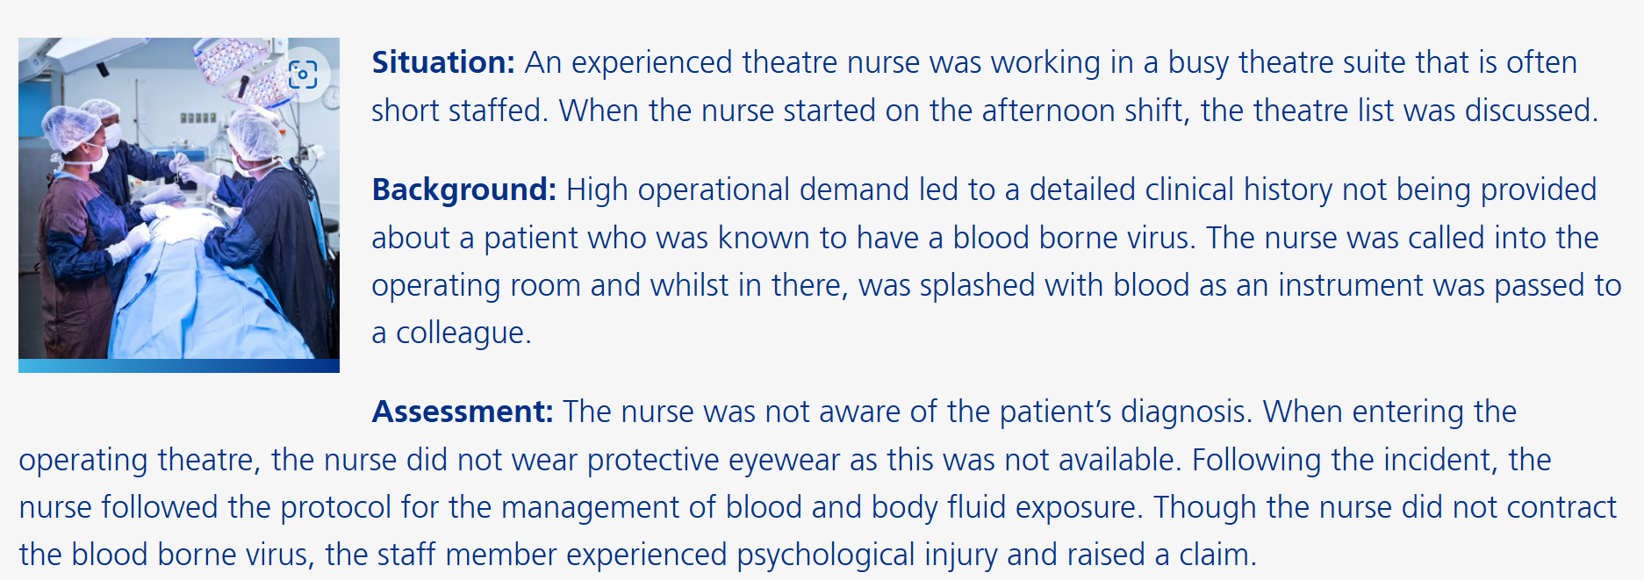
Case Story Theatre Nurse
https://resolution.nhs.uk/learning-resources/neonatal-jaundice-case-story/

Slide 16








System Engineering Initiative for Patient Safety (SEIPS) Model
7
External
environment
Internal
environment
The SEIPS framework is used here to demonstrate the potential for learning from this claim to support system-wide improvement.
Tools & technology
Outcomes
System performance
Organisation
Processes
Tasks
Person
Human wellbeing
The work system can influence processes, that is the work as done, which in turn shapes outcomes.
Advise / Resolve / Learn
Notes:
SEIPS is a framework that can be used for understanding outcomes within complex socio-technical systems, such as healthcare systems.
This figure demonstrates how the work system (or socio-technical system) can influence processes (the work done) which in turn will shape outcomes.
As seen within the slide, there are several broad elements that make up the work system: The external environment, the organisation, the internal environment, tools and technology tasks and person(s)
The framework was first described by Carayon et al. (2006) allowing both a systems engineering approach, with human factor principles embedded within it.
Shift purpose of blame: aligns with PSIRF – looking at the system model

Slide 17
Using SEIPS to support learning from patient safety events
Patient safety events are often because of multiple interactions between the work system factors, rather than a single element
Using SEIPS can help prompt us to look for interactions between systems instead of focusing on simple linear cause and effect relationships
Allowing for learning responses to focus on potential wider system issues, not individuals
https://resolution.nhs.uk/learning-resources/neonatal-jaundice-case-story/
Notes:
System: not blame

Slide 18

SEIPS - Person
NHS England Explorer Questions (1)
Illustrative case story
  Tell me about the patient mix.
  Described the team who deliver patient care
  Who else is part of the team?
  How familiar are the team members with care processes/pathways?
  Are roles/responsibilities clearly defined?
  Describe how training is organised to support safe care.
  Describe the team dynamics
  Describe the impact of personal factors, e.g. stress, tiredness
  Patient with blood borne virus
  Theatre team
  Understaffing; increased workload with potential decreased focus on preventative safety measure.
  Clinical competence.
  Hierarchy and power dynamics; its influence on whether concerns of PPE were raised.
  Burn out & stress.
  Proactive risk management
B1465-SEIPS-quick-reference-and-work-system-explorer-v1-FINAL.pdf (england.nhs.uk)
Advise / Resolve / Learn
Notes:
Left generic NHSE slides: explorer questions – you can think your own – some of our thoughts – anything missing
Pilot mode: does it without thinking: sometimes make mistakes
Systems around the person

Slide 19

SEIPS - Tasks
NHS England Explorer Questions (1)
Illustrative case story
  Handover lacked key infection risk information; staff entering theatre without full awareness
  PPE not standardised as a safety requirement
  Time pressure due to understaffing
  Tell me about the task demands you face?
  Describe the tasks which are complex or challenging to carry out?
  Talk me through your experience of the workload?
  Are there time pressures? If yes, please tell more.
  Does task repetition/monotony occur in this system?
  Do you have to reprioritise/ reorganise?
B1465-SEIPS-quick-reference-and-work-system-explorer-v1-FINAL.pdf (england.nhs.uk)
Advise / Resolve / Learn

Slide 20
SEIPS - Tools and Technology
NHS England Explorer Questions (1)
Illustrative case story
  Describe the equipment/tools you use
  Describe the equipment design
  Share your insights into equipment reliability
  Describe how information is presented(eg records IT systems)
  Describe alarms and alerts
  Are any tasks automated?
  Describe where equipment is positioned. Is this optimal
  Are tools/technology maintained and updated?
  Are manuals, procedures and supports accessible?
  Training, availability & maintenance
  Eyewear was not readily available at point of use
  Lack of structured pre-theatre checklist; PPE availability and suitability were not assessed prior to the procedure
  Accessing information; multiple screens/tabs open masking the notification of risk.
B1465-SEIPS-quick-reference-and-work-system-explorer-v1-FINAL.pdf (england.nhs.uk)
Advise / Resolve / Learn

Slide 21
SEIPS - Internal environment
NHS England Explorer Questions (1)
Illustrative case story
  Does the workspace support safe patient care/task performance?
  Share your thoughts on the layout of the environment
  Is the workspace appropriate for the task?
  Where are the tasks completed?
  Describe any distractions you experience regularly
  Do interruptions impact patient care/task performance? If yes, how?
  Describe the impact of the ambient environment (eg lighting, noise, air quality)
  High pressure environment; may lead to short cuts
  Physical environment; cluttered may increase accidental exposure to risk
  Accessibility; are PPE areas clearly marked and accessible
B1465-SEIPS-quick-reference-and-work-system-explorer-v1-FINAL.pdf (england.nhs.uk)
Advise / Resolve / Learn

Slide 22
SEIPS - Organisation
NHS England Explorer Questions (1)
Illustrative case story
  Tell me about how the patient pathways work
  Describe the information flow (how information is communicated)
  What is the communications workload like?
  Tell me how new information is flagged?
  Where is new information held?
  Describe the leadership and supervision arrangements
  Describe how work is scheduled/allocated
  Describe staffing levels and resourcing
  Describe the safety/organisational culture
  Describe how change management works
  Reactive rather than proactive safety culture
  Psychological support within organisations
  High operational demand
  Lack of visible leadership presence in the theatre; may have contributed to gaps in care.
B1465-SEIPS-quick-reference-and-work-system-explorer-v1-FINAL.pdf (england.nhs.uk)
Advise / Resolve / Learn

Slide 23
SEIPS - External environment
NHS England Explorer Questions (1)
Illustrative case story
  Describe any relevant national targets
  Tell me how the following impacts (if at all):
  National Infection Prevention and Control Guidance
  COSSH Risk assessment
  Regulatory and Professional standards: CQC & NMC Code of conduct
  Policy and regulatory demands
  Accreditation standards
  Political decision making
  Global events
B1465-SEIPS-quick-reference-and-work-system-explorer-v1-FINAL.pdf (england.nhs.uk)
Advise / Resolve / Learn

Slide 24
SEIPS - Processes and outcomes
Processes
Outcomes
  The work system can influence processes, that is the work as done, which in turn shapes outcomes.
System Performance:
  Operational efficiency
  Better infection control measures
  Improved regulatory compliance
Human Wellbeing:
  Reduction in patient harm.
  Improved patient experience.
  Increased staff satisfaction.
Advise / Resolve / Learn
Notes:
Next steps to ensure you get those outcomes: ?how do we change the way of working; where are you going to focus?
Generic outcomes: personalise that

Slide 25
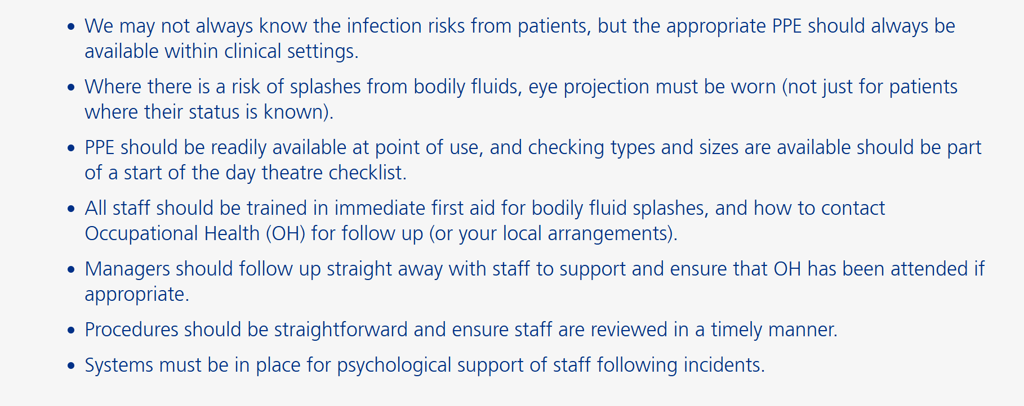
Recommendations from the case story:
https://resolution.nhs.uk/learning-resources/neonatal-jaundice-case-story/
Notes:
Generic to support the case story: support from SM experts – some principles here to consider.

Slide 26
Takeaways
environmental suitability and risk knowledge when working with chemicals.
Use claims data to corroborate other data trends to improve and inform business cases.
Hierarchy of Controls – eliminate, adapt.. E.g. revisiting risk assessments as a roles change/evolve.
Highest risk of error observced is when diluting chemicals.
Notes:
Abi
Claims are the tip of the ice burg; rear view mirror; important to use claims with other safety metrics for organisational learning.

Slide 27

Thank you for listening
Safety and Learning team
nhsr.safety@nhs.net
020 7811 2700
@NHSResolution
Please use the QR code or use the link here
S&L Rapid Feedback Survey 2024 (smartsurvey.co.uk)
to complete the short survey
Advise / Resolve / Learn
Notes:
Upcoming: WPV report

Slide 28
Duty of Candour/Engagement and Involvement
Project Leads Trudy Sexton Patient Safety Manager
Simon Dallas Head of Quality Improvement

Slide 29
The Problem to Solve
Variation in consistent timely and compassionate engagement by staff following the occurrence of a serious incident.
There has been continued work to improve the involvement and engagement with patient, families and staff following a serious incident, to promote timely compassionate conversations to build relationships and share learning
Notes:
Learning from the Serious Incident process was consistently raising the issue of the lack of consistent undertaking of the Duty of Candour – this has been described in the above ‘Problem to Solve’
We were very clear that we would apply the QI process

Slide 30
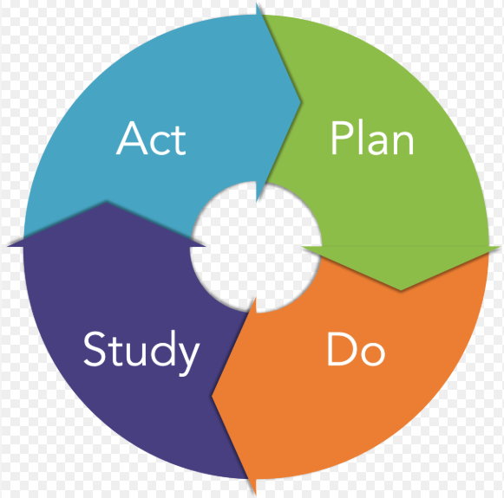
The Plan
All patients, families and carers will receive the required support and opportunity to contribute their experiences and insights and to be actively involved in the patient safety incident process. By collectively generating testing and measuring impact of ideas.
The initial contact will occur within the first 10 days 100% of the time following the identification of a serious incident and will be maintained throughout the process by June 2024.
Notes:
In true QI style we got our heads together in clearly define the end goal and be clear about ‘what good looks like’

Slide 31
Our Rationale
Staff will have a clear understanding of the Duty of Candour and the steps
Staff will be confident in implementing the Duty of Candour, including contacting believed families and carers
Carers and families will be engaged from an early stage
Reports will reflect the feelings and concerns of the family and carers
Learning will be captured and used to inform improvements

Slide 32

Measuring
Notes:
In true QI style we began by measuring!
We measured the number of times the Duty of Candour was completed within timeframe over a period of 2 years and those that were either not completed or completed outside of timeframe were examined to understand why
Most were due to;
No NoK on the clinical records – this would mean that often we would need to contact the coroner to identify the correct person
Learning need – not fully understanding the process or requirement

Slide 33
Relational Coordination
(RC)
Notes:
We wanted the right people in the room, with the right passion and experience
Relational coordination enabled us to identify all who would be able to influence the outcome and help lead the changes

Slide 34
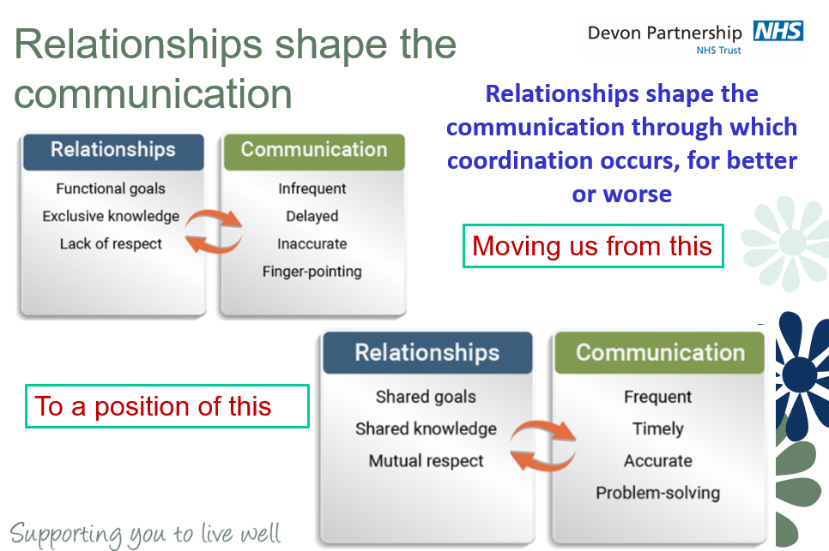
Notes:
We wanted to create a group of people who had shared goals and expert knowledge

Slide 35
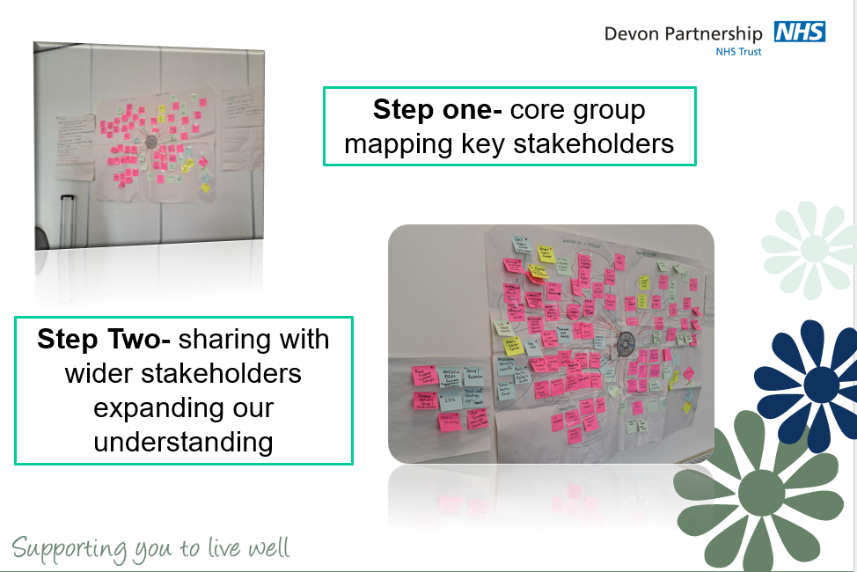
Notes:
The PSIRF implementation team sat in a room and began to identify who would be in the perfect position to help
Each post it represents either a person or a meeting/committee.
This looks chaotic but made perfect sense to us! We were able to identify both direct and indirect relationships that would support the improvement

Slide 36
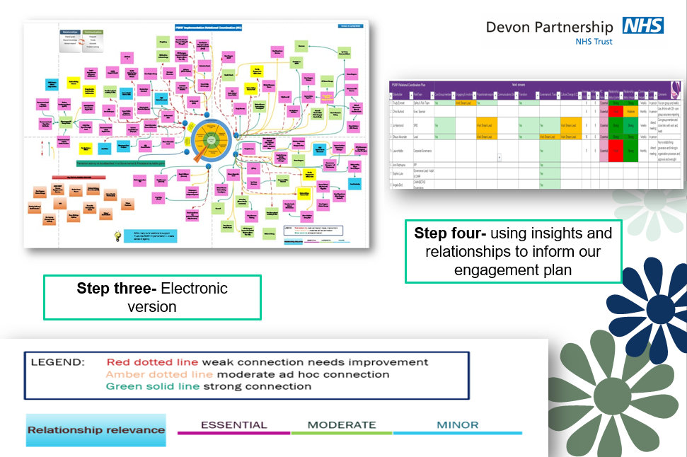
Notes:
This is the electronic version
We identified the existing relationships we have with the required people and where the relationship was strong, we decided on the necessary steps to improve and strengthen this, for example arranging face to face meetings to share the goal and aim of the project, and gain sign up
In this diagram, we identified where we had weak connections with a red dotted line, moderate ad hoc connection with an amber dotted line and where the relationship was strong, we used a green solid line

Slide 37
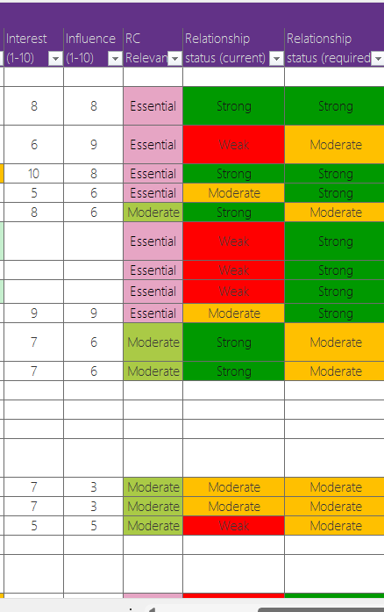
Notes:
Each row here represents a person and the columns are scored;
Interest 1-10
Influence 1-10
Relevance essential or moderate
Current relationship
Required relationship

Slide 38

Step 1
  Clinicians
  Together representation
  People with lived experience
  Safe From Suicide Team
  Deputy Director Nursing
  Governance Managers
Notes:
We began each meeting with a story from either a staff member or a person with lived experience. This was a way of making sure that the importance, impact and potential harm of not getting this right was reaffirmed right at the beginning of the meeting – this made sure that the meeting was focussed, and the tone was that of positive movement towards the improvement
The aim is to understand the experience of staff when undertaking the Duty of Candour process, by engaging with staff and listening to the constraints and hesitations that create a delay. We created a monthly working group that was informed by the Relational Coordination process that will ensure we fully understood the knowledge and experience of key stakeholders, both internal and external to the organisation. We intentionally kept the meeting frequent and several so this was not a drain on the already busy staff
We were clear that to establish this working group we needed people with lived experience, we were fortunate to be able to engage several people with lived experience of either receiving care, being a carer or family member or having been through the investigation process with a loved one

Slide 39
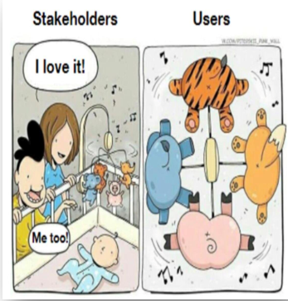
Identify the Barrier
Notes:
What is it that is stopping people from completing the DoC
There is no point jumping in to resolve the issue when we do not understand the barriers. It is all very good looking with our own focus and having expectations, but if we are not the ones completing the process we have a very biassed view

Slide 40
Questions
How confident do you feel when undertaking the Duty of Candour?
How supported do you feel when undertaking the Duty of Candour?
How confident do you feel with the information that needs to be captured for the Duty of Candour?
What resource would you like to have access to support you undertaking the Duty of Candour?
Notes:
The questions were created and agreed in the group and agreed by all. We wanted a simple set of questions that would be easy to complete that gave us a clear idea of what was needed

Slide 41
Themes
Guide or handout which could briefly go through the steps of what needs to be completed.
I completed the Duty of Candour training but as I do not have to apply this very often, its then hard to remember everything when you then need to undertake it.
I think it is important to recognise that in order to best support the person to whom we have the duty we need to listen to their needs ie it may take more than one call and they may not want something in writing so we should undertake to honour their wishes.
Access to quick advice - DOC is not always straight forward
Guidance on when to do a letter, when to do a phone call etc
Guidance on when DOC is appropriate & when its not - time frames since discharge, what if we have seen the person only once some months ago etc
I think DOC is currently considered if there is a death but often not in other circumstances.
Staff did not feel confident when the act applied
Staff were worried about what they could say
Staff were concerned about contacting out of the blue
Staff did not feel supported through the process
Staff wanted template letters
Notes:
The above is a section of the quotes from the feedback but the themes were;
Not feeling confident in when the DoC applied
Not feeing confident in how to contact people, fear of calling out of the blue
Staff were worries about saying the wrong thing and worried that they would get in trouble

Slide 42
Outcomes
Weekly governance meetings
Increased training, including to Governance Leads
Weekly drop in sessions over teams with the Duty of Candour Lead
FAQ document accessible to all staff
‘Bundle’ of support
Gain feedback from patients/carers and staff
Notes:
Weekly governance meetings
These meetings are held once a week where we run a reportall moderate and above incidents and review the findings where the Duty of Candour applies. Where we see a gap or need to prompt staff we do
Categorise in greater than 10 days, less than 10 days, could not complete due to no NoK or lack of engagement and did not completed Duty of Candour
Increased training, including to Governance Leads
We have added Duty of Candour to all the current training and delivered sessions to the local learning from experience groups, we have introduced the Duty of Candour into every possible training session.
Weekly drop in sessions over teams with the Duty of Candour Lead
This is a session that is available to all where people can just drop in and ask a question directly to the Duty of Candour Lead
FAQ document accessible to all staff
This is added to the back of the policy and included in the ‘Bundle’
‘Bundle’ of support
This has been created as a ‘one stop shop’ for all of the information regarding the Duty of Candour
Gain feedback from patients/carers and staff
This is in order to make sure we are getting it right and if not to continuously improve

Slide 43
Data Capture
Contacted in less than 10 days
Contacted in more than 10 days
Not completed as no NoK or no engagement
No Duty of Candour completed
Notes:
We use the status field to capture information so we can run a reports to calculate compliance and identify any gaps
Awaiting CoD
Awaiting further info
Contacted Greater than 10 days
Contacted Less than 10 days
DoC Applied to Previous Incident
DoC not Completed, No NoK or Failure to Engage
Harm was not sustained whilst in the care of the Trust
Manager Emailed for Update
No Duty of Candour Completed

Slide 44
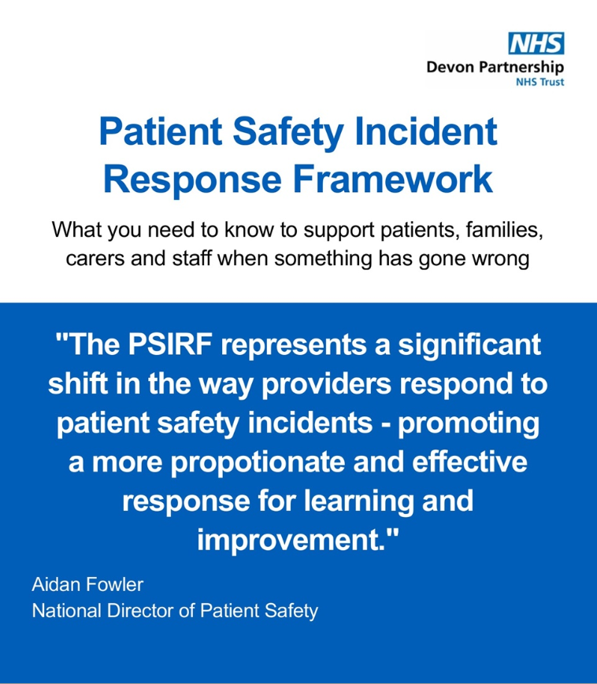
Bundle
Notes:
The principle outcome is the creations of an eBook that contains all the information that could be required under the Duty of Candour
This is constantly updated so that we are never sharing out of date information

Slide 45
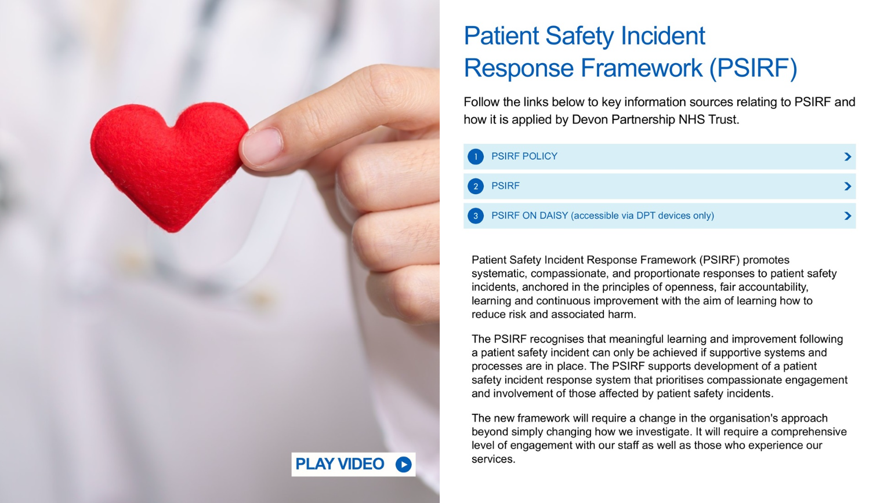
Heading
  Copy
  Copy
Notes:
The first page is an oversight about PSIRF, on opening the page an avatar that speaks for about 50 seconds, a small written explanation and links to the relevant documents

Slide 46
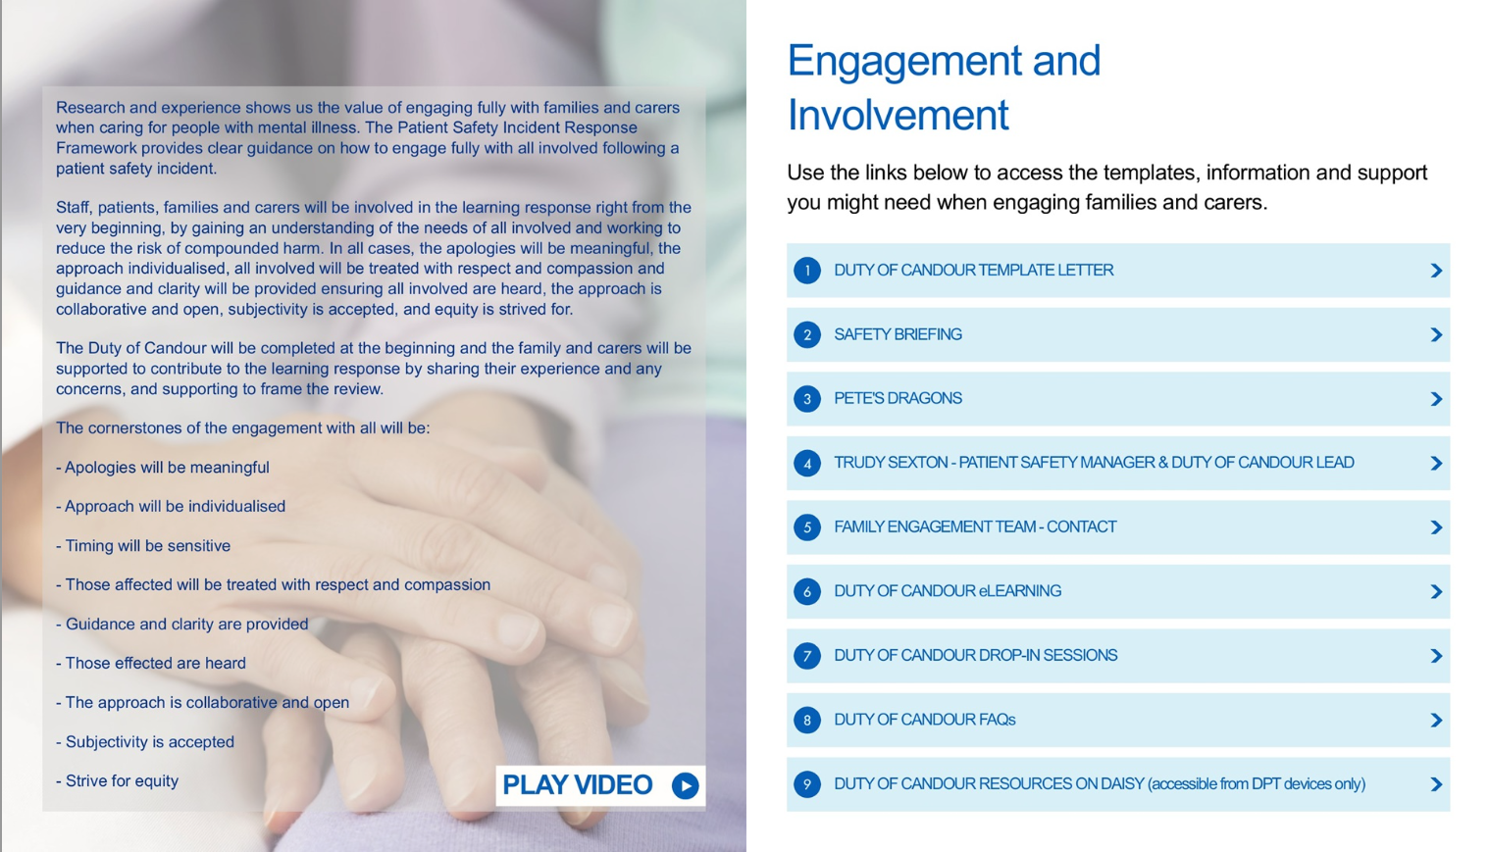
Heading
  Copy
  Copy
Notes:
The second page is about all things Duty of Candour and engagement
This contains the Duty of Candour template letter
Contact details of voluntary services (for example support for people following suicide)
Contact details for the relevant leads
Links for the training and elearning
Link for drop in session
Link to the correct page on out intranet

Slide 47

Heading
  Copy
  Copy
Notes:
The final page is all about support for staff. Incidents can have a significant impact on staff and the feeling of being involved in an investigation can be overwhelming and anxiety provoking
This page was designed to provide links to all support that is available within the trust and externally

Slide 48
Engaging with people with lived experience
Working with people with lived experience has been invaluable. The writing of letters, the tone of communications, the timing of engagement and the expectations of timescales have all been updated because of the input from a person with lived experience
Notes:
There are so many examples of where the input from people with lived experience have stopped us in our tracks to fix a process or amend a language. Everything that has been produced has been agreed by them
Before each meeting we has a preparatory meeting and after every meeting we had a mop up or debrief session. This meant that we were able make sure they felt supported through the process
If there is a take away from this session, it is that we cannot make improvements to our service with any confidence that we have got it right unless we have involved the people who will be at the receiving end

Slide 49


Breakout groups
We are now going to split into two breakout groups:
South West
South East
Please choose the region you are based in.
GET IN TOUCH
Notes:
QR code above. https://forms.office.com/e/9wauR68FMX

Slide 50

Summary & Close
We hope you have found this event useful, please remember complete this short survey here to help us with future events
SCAN ME
GET IN TOUCH
FOLLOW US
https://forms.office.com/e/9wauR68FMX
nhsr.safety@nhs.net
NHS Resolution
Notes:
QR code above. https://forms.office.com/e/9wauR68FMX

Slide 51



Thank you for your time
@NHSResolution

